Slide 1
Computer Networking
Shalini Bhavanam

Slide 2
Key words:
Basic Definitions
Classification of Networks
Types of networks
Network Topologies
Network Models

Slide 3
Basic Definitions
Station
A station is a computer workstation or computing device attached to a network.
Segment
A segment is a cable between any two stations or network devices, or between any station and network device.
Network Device
A network device is any device used to interconnect segments of the network.

Slide 4
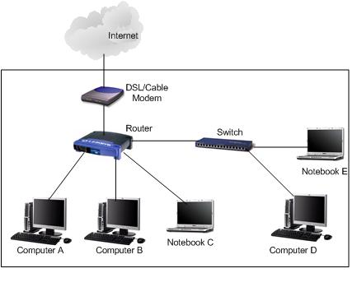
Switches
We use switches to connect computers, printers and servers within a building or campus. It serves as a controller allowing network devices to talk to each other.

Slide 5
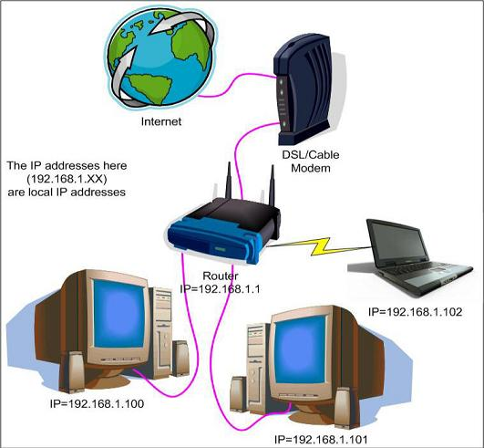
Routers
Switches create a network whereas router connects networks. A router links computers to the internet, so users can share the connection. It acts as a dispatcher choosing the best path for the information to travel.

Slide 6
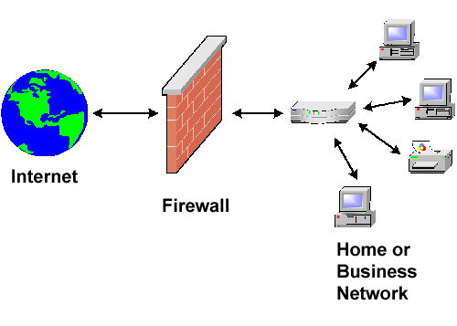
Fire Wall:
A network firewall protects a computer network from unauthorized access. These firewalls guard an internal computer network against malicious access from the outside. It also hides internal LAN address. Routers contains these firewall components.

Slide 7
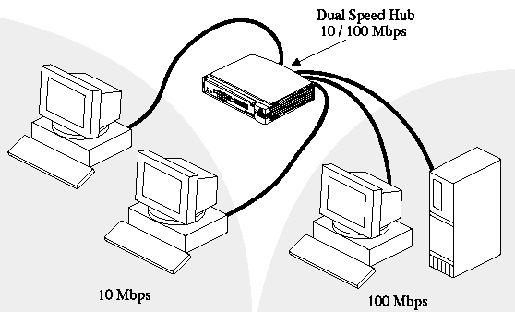
Hub:
It is a device connecting multiple devices together and making them act as a single network segment.

Slide 8
Basic classification of networks
Networks are basically classified into
Broadcast network
Point-to-point network

Slide 9
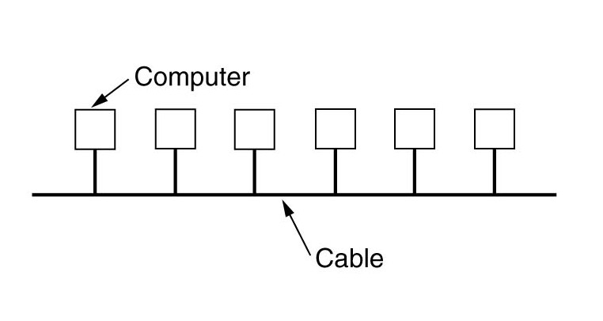
Broadcast networks:
These networks have a single communication channel which is shared by all the machines. Every machine receives the packet which is in the communication channel. It processes the packet, if packet is for some other machine, it just ignores that.

Slide 10
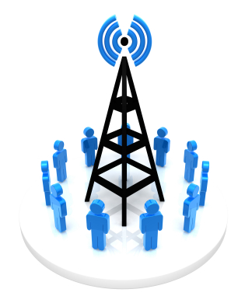
Example:
Airport announcement for some flight number requesting those people to report at gate B2.
There is another concept related to this broadcasting, which is called multicasting. In multicasting, if each machine is considered as a group, then the packet send to that machine will be given to all the members in the group. For example, group mail.

Slide 11
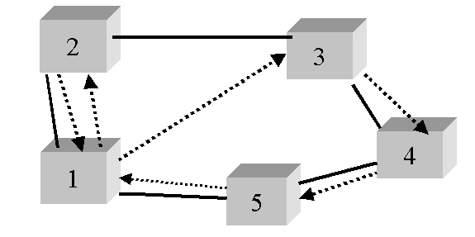
Point-to-point networks:
This network consists of many connections between individual pairs of machines. For a packet which is known as a message may need to go through different intermediate machines before reaching final destination. So there may be multiple routes with different lengths. There are some algorithms known as routing algorithms which are very important in point to point networks.

Slide 12
The networks can be small networks or larger networks. The main types of networks are
LAN(Local Area Network)
This network connects computers in a single office or single building or group of buildings. This network can also be connected to other networks using telephone lines or radio waves.
Example:
Any Company
MAN(Metropolitan Area Network)
These connect networks around a town or city. This network is larger than LAN but smaller than WAN. This network is mainly designed for a town or city. This network is a bit faster than LAN with the usage of fiber optical cable or digital media.
Example:
Communication among universities related to a single organization located at different places.
Company having branches at different places.

Slide 13
WAN( Wide Area Network)
These networks are between different buildings, or towns or even different countries.
They are like dispersed telecommunications network. These networks can be privately owned or rented. They are generally used for referring public usage.
Internet is the largest WAN spanning the earth.
These are the major types in networks. Some other types are
Wireless Local Area Network.
Campus Area Network
Storage Area Network.
System Area Network(Cluster Area Network)

Slide 14
Network Topology
Network topology is the layout pattern of interconnections of the various elements of a computer network. Topology can be considered as a virtual shape or structure of a network. These topologies may be
physical
logical.
Physical Topology
Physical topology is the actual physical design of the network including devices, location and cable installation.
Logical Topology
Logical topology refers to how data is actually transferred in a network
In order to study the network, we use graph theory.

Slide 15
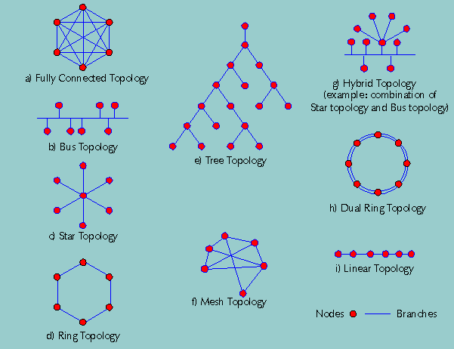
Different types of physical topologies are
Point-to-point topology
Bus (point-to-multipoint) topology
Star topology
Ring topology
Tree topology
Mesh topology
Hybrid topology

Slide 16
Point-to-point topology:
This is the simplest topology in which two nodes are directly connected to each other. Each message has only one possible receiver. There is a permanent link between two end points.

Slide 17
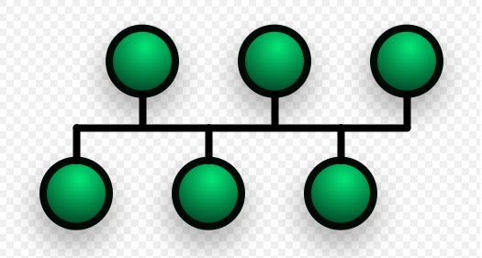
Bus Topology:
In this topology, each machine is connected to a single cable. We use a terminator to prevent the signal in bouncing back. The signal is transferred in both the directions.
Uses a terminator
Inexpensive
Costly to manage the network. If the network cable breaks, the entire network will be down.

Slide 18
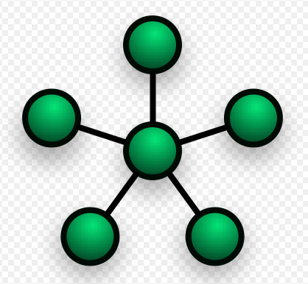
Star Topology
In this topology, each network host is connected to a central hub
Uses point-to-point connection.
Easy to add additional nodes
Easy to maintain.
Hub represents a single point of failure.

Slide 19
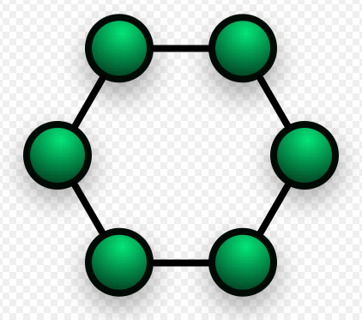
Ring Topology
A network that is set up in a circular fashion.
Data travels in one direction where each device on the right acts as a repeater.
The network is dependent on the ability of the signal to travel around the ring.

Slide 20
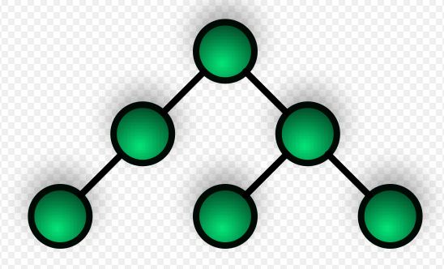
Tree Toplogy
This topology is also known as hierarchy network.
Consists of central root node
levels

Slide 21
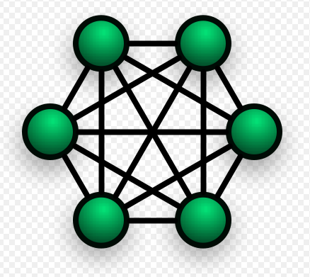
Mesh Topology
costly and complex involving different paths for the message to travel between nodes.
Efficient for small number of nodes.

Slide 22
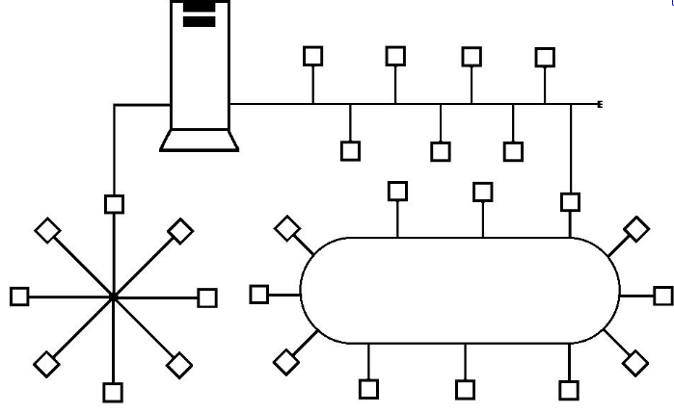
Hybrid Topology

Slide 23
Network Models:
Network models define a set of network layers and how they interact. The two important network models are
OSI Network Model
TCP/IP Model

Slide 24
OSI Network Model (Open Systems Interconnection Model)
There are different layers in this model. They are
Physical layer
Data link layer
Network layer
Transport layer
Session layer
Presentation layer
Application layer

Slide 26
Physical Layer
This layer deals with
Establishment and termination of a connection to a communications medium.
The actual wiring and hardware that support the network connection.
Data Link Layer
This layer prepares the packets for transmission through the physical layer and handles problems such as packet collision. Ethernet is a data link protocol.
Network Layer
This layer adds routing information to each data packet. IP, the Internet Protocol is an example of a network protocol.

Slide 27
Transport Layer
In this layer, data is packaged and tracked to assure that the packets have been received correctly. TCP(Transmission Control Protocol) is a transport layer protocol.
Session Layer
This layer is responsible for establishing and maintaining the connection between communicating machines.
Presentation Layer
In this layer, data is encrypted, translated or compressed before it is transmitted.
Application Layer
There are the network applications that use the data being transferred, for example HTTP or FTP.

Slide 28
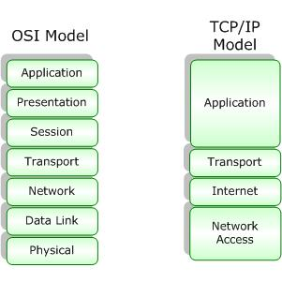
TCP/IP Model:
TCP/IP is based on a four-layer reference model. All protocols that belong to the TCP/IP protocol suite are located in the top three layers of this model.

Slide 29
Network Interface
Specifies details of how data is physically sent through the network, including how bits are electrically signaled by hardware devices that interface directly with a network medium, such as coaxial cable, optical fiber, or twisted-pair copper wire.
Internet
Packages data into IP datagrams, which contain source and destination address information that is used to forward the datagrams between hosts and across networks. Performs routing of IP datagrams.

Slide 30
Transport
Provides communication session management between host computers. Defines the level of service and status of the connection used when transporting data.
Application
Defines TCP/IP application protocols and how host programs interface with transport layer services to use the network.

Slide 31
Thank you

