Slide 1
Randomized and De-Randomized Algorithms
Jeff Kinne, Indiana State University
Slides online at kinnejeff.com

Slide 2
The Plan…
Randomized Algorithms – examples
How to “de-randomize” a randomized algorithm

Slide 3
Research
Versus industry/internship…
Lower pay (probably)
Less applied
But
You choose what to work on (mostly)
More cutting-edge, forward-looking
Give presentations, meet people
Write a paper, tell others about your results

Slide 4
Randomized Algorithms

Slide 5
Median Finding
Unsorted list of #’s 6, 10, 0, 2, 3, 77, 55, 32
Find median: 6
Sorting – n log(n) running time
Randomized – quickselect, O(n) running time
Notes:
Randomized algorithms
Primality testing
Trial division – example of how fast, pseudocode
Fermat’s test – example of how fast, pseudocode
Miller-Rabin – example of how fast, pseudocode
AKS – example of how fast, pseudocode
Relevance for RSA
Factoring?
Poly Identity testing
Schwarz-Zippel – example and how fast, pseudocode
Deterministic? – try all – example and how fast
Application?
An optimization problem, approximation algorithm
Wow, randomized algorithms are awesome. Long live randomized algorithms!
Circa mid 80’s.
Some settings where randomized is definitely required – communication complexity, cryptography
But…
PRG – definition, intuition.
PRG for scientific simulations
LCG, problems with LCG
Others - …
Cryptographic PRG
requirements
Based on OWF – RSA, BBS, …
PRG for derandomization
Different requirements than crypto
NW
Limits on efficiency?

Slide 6
Shortest Path
Breadth-first search Depth-first search Dijkstra’s algorithm ...
Running time – good
Memory space – bad!
“Drunkard’s walk”
Connectivity on undirected graphs
Memory space – good!
Running time – not as good
“De-randomized” – Reingold

Slide 7
Is ___ Prime?
Is 2 a factor? Is 3? … Is $p^{1/2}$?
Fermat test
Pick a at random
If $a^{n−1} ≢1 mod n ⇒$ n not prime.
Not always correct – Carmichael numbers
Miller-Rabin – always correct with high probability
Application – RSA cryptography needs large primes

Slide 8
Is ___ Prime?
Miller-Rabin test
try a = 2, 3, …, $O(\log^{2}{(n))}$
Generalized Riemann Hypothesis $⇒$ always correct
AKS test
Always correct!
Can do better?

Slide 9

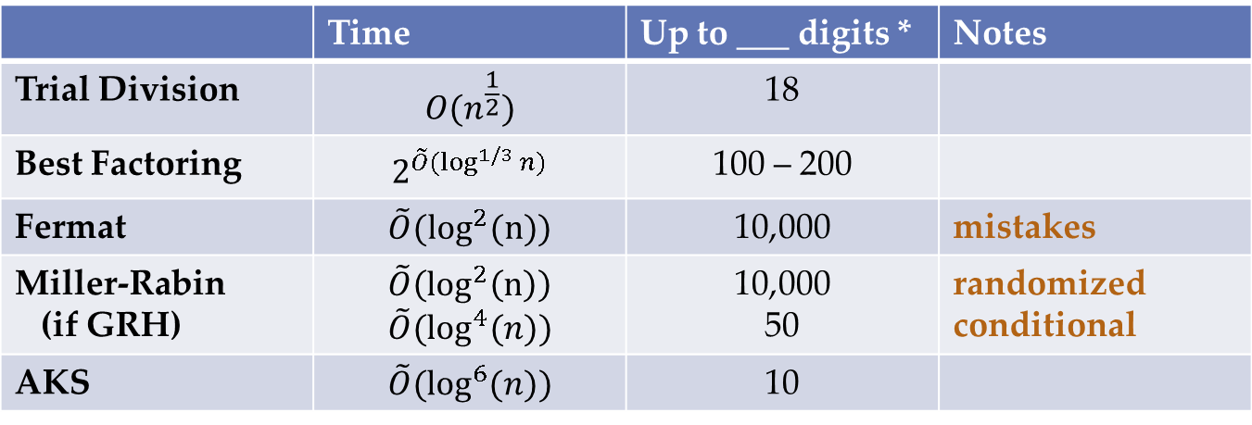
Is ___ Prime?
* Up to ___ digits – for # operations $≤{10}^{9}≈2^{30}$
RSA requires – about 300 or 600 digit primes
 | Time | Up to ___ digits * | Notes
Trial Division | $$O(n^{\frac{1}{2}})$$ | 18
Best Factoring | $$2^{\tilde{O}(\log^{1/3}{n)}}$$ | 100 – 200
Fermat | $$\tilde{O}(\log^{2}(n))$$ | 10,000 | mistakes
Miller-Rabin (if GRH) | $$\tilde{O}\left(\log^{2}\left(n\right)\right) \\ \tilde{O}(\log^{4}(n))$$ | 10,000 50 | randomized conditional
AKS | $$\tilde{O}(\log^{6}{(n))}$$ | 10

Slide 10
General-Purpose Derandomization

Slide 11
Randomized Algorithm
Fermat test
n prime $⇒$test correct
n composite, not Carmichael $⇒$ correct for $≥$ ½ of all a’s
Randomized Alg A
For any input n
$\underset{a}{Pr}\left[A\left(n, a\right)correct\right]≥\frac{2}{3}$
Derandomize
Evaluate A(n, a) for all possible a
Running time: time(A) $×$ #a

Slide 12
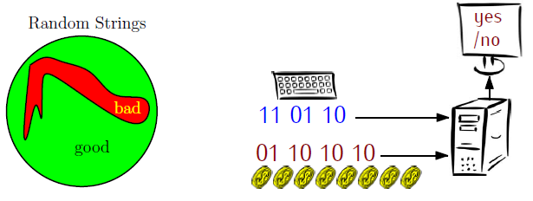
Pseudorandom Bits
Replace random a by “pseudorandom” a
n
a

Slide 13
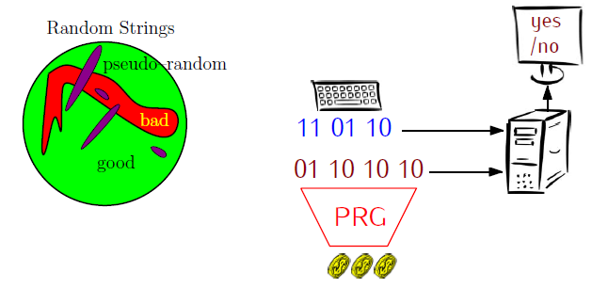
Pseudorandom Bits
Try A(n, PRG(s)) for all seeds to PRG
Running time: (time(A) + time(PRG)) $×2^{seed length}$
n
a
s

Slide 14
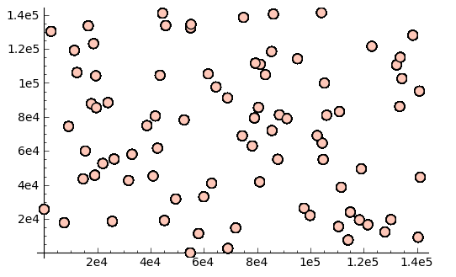
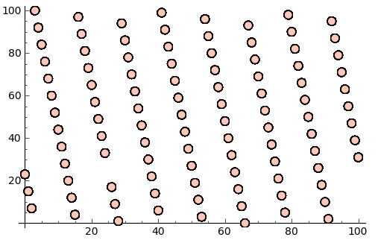
PRGs
Generators | Uses | Security | Speed
LCG, LSFR | scientific simulations | statistical tests | very fast
BBS, RSA | cryptography | any poly-time test | slower
NW, SU | Derandomization | any fixed-poly-time test | slower
LCG
RSA

Slide 15
PRG Derandomization
“Major Important” Result …
Plausible assumptions $⇒$ PRG’s of exponential “stretch”
$⇒$ remove randomness with polynomial slowdown (aka BPP = P)
E.g., time $\tilde{O}\left(\log^{2}\left(n\right)\right)$ might become $\tilde{O}\left(\log^{18}\left(n\right)\right)$
What is best possible from this approach?
Perhaps… getting a quadratic slowdown… perhaps…

Slide 16
Questions/Goals
Actually implement “theoretical” PRGs, what is best possible running time?
For particular problem (e.g., primality) – best possible derandomization?
New PRGs that are both very fast and secure, for particular kinds of randomized algorithms?

Slide 17
Other Projects…
Distributed factoring, Mersenne prime search
Computational complexity
Many things…
P vs NP
Lower bounds for … matrix permanent
…
Brain trauma AI
…

Slide 18
The End
Thank you!
Slides online at kinnejeff.com

